Slide 1
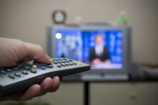
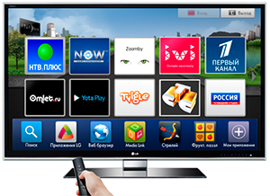
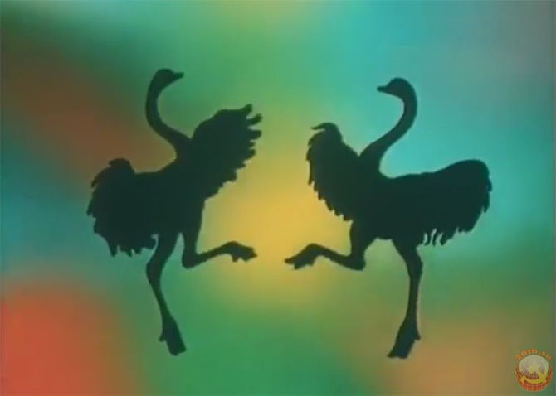
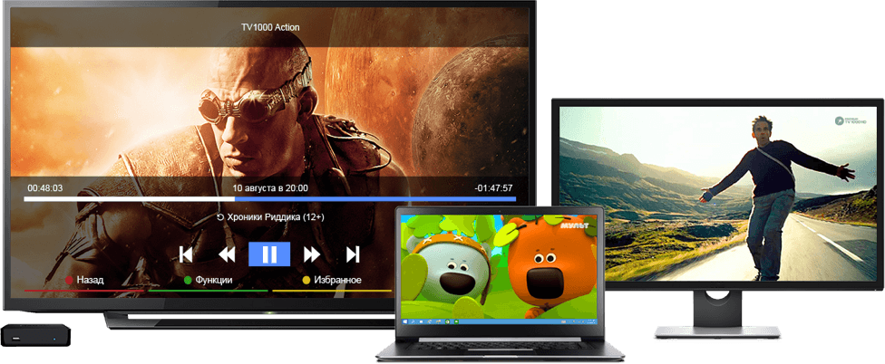
Guess the topic of the lesson

Slide 2
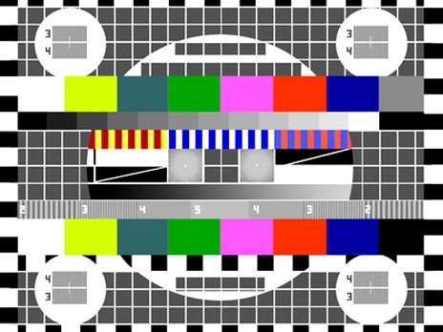
TV Programm
TV Programmes

Slide 3
Talk Shows
Music Shows
Sitcomes
Drama
cartoons
News
Reality Shows
Science Fiction
Sports

Slide 4
LOVE | Don’t like
LIKE | Hate
Great, exciting, interesting, fantastic, fine, wonderful | Boring, awful, terrible, dull
I don’t like…. I think it’s…
I like…. I think it’s…..

Slide 5
IT,HE,SHE
DOES
пиши
I, we, you, they
do
Do you like….- Yes, I do/ No, I don’t

