Slide 1
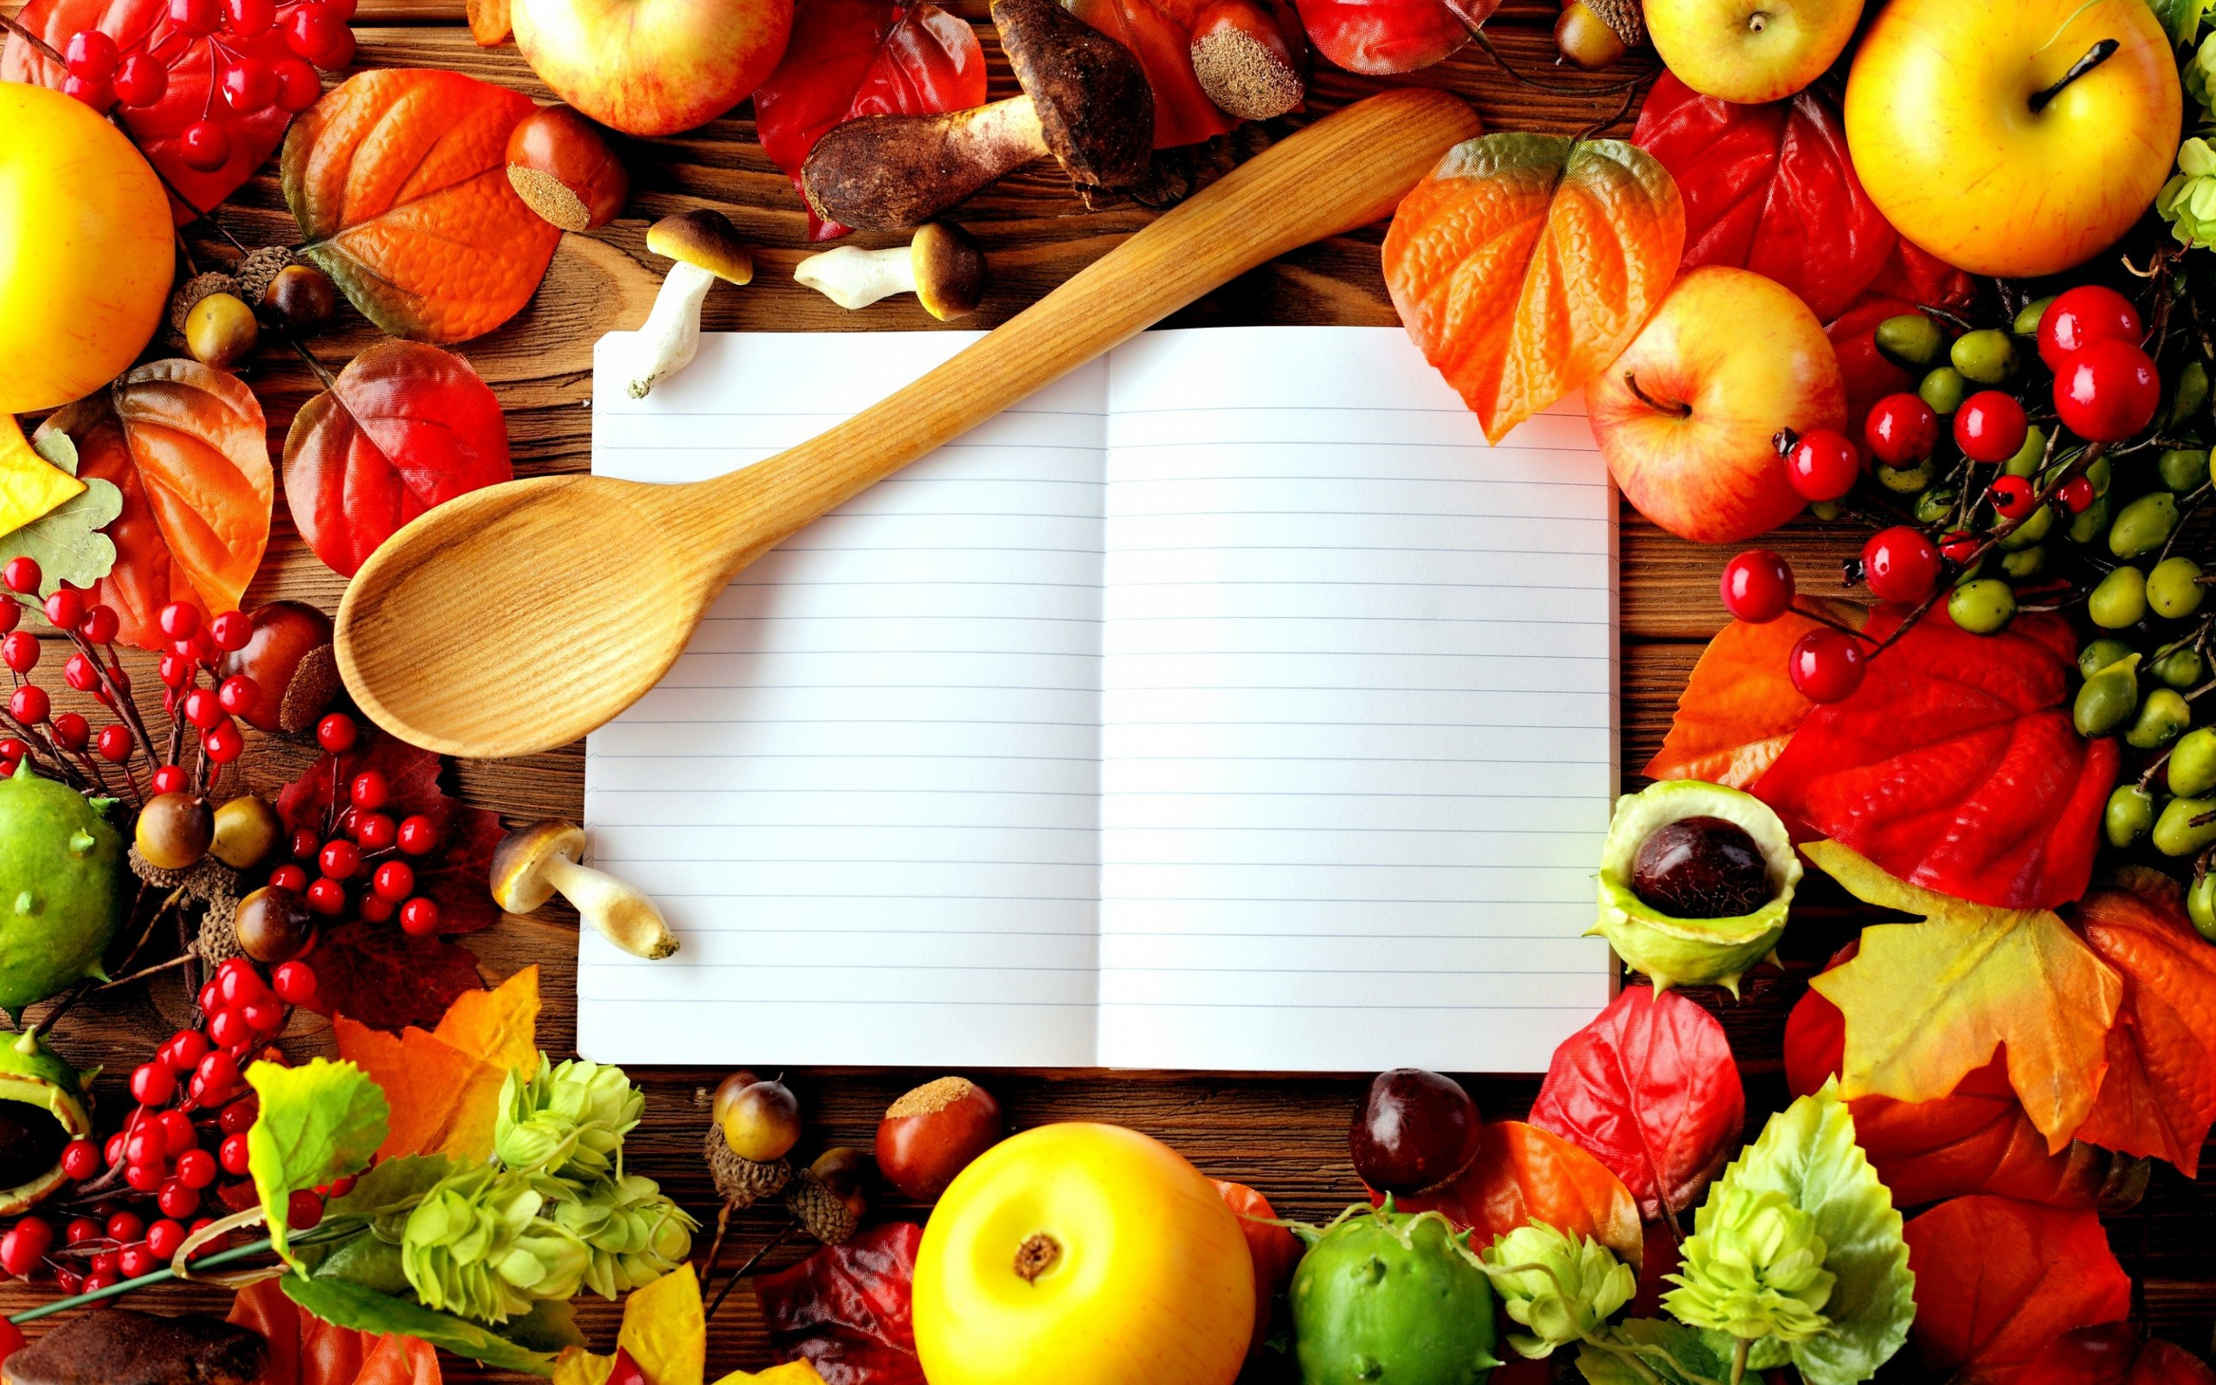
Good morning!

Slide 2
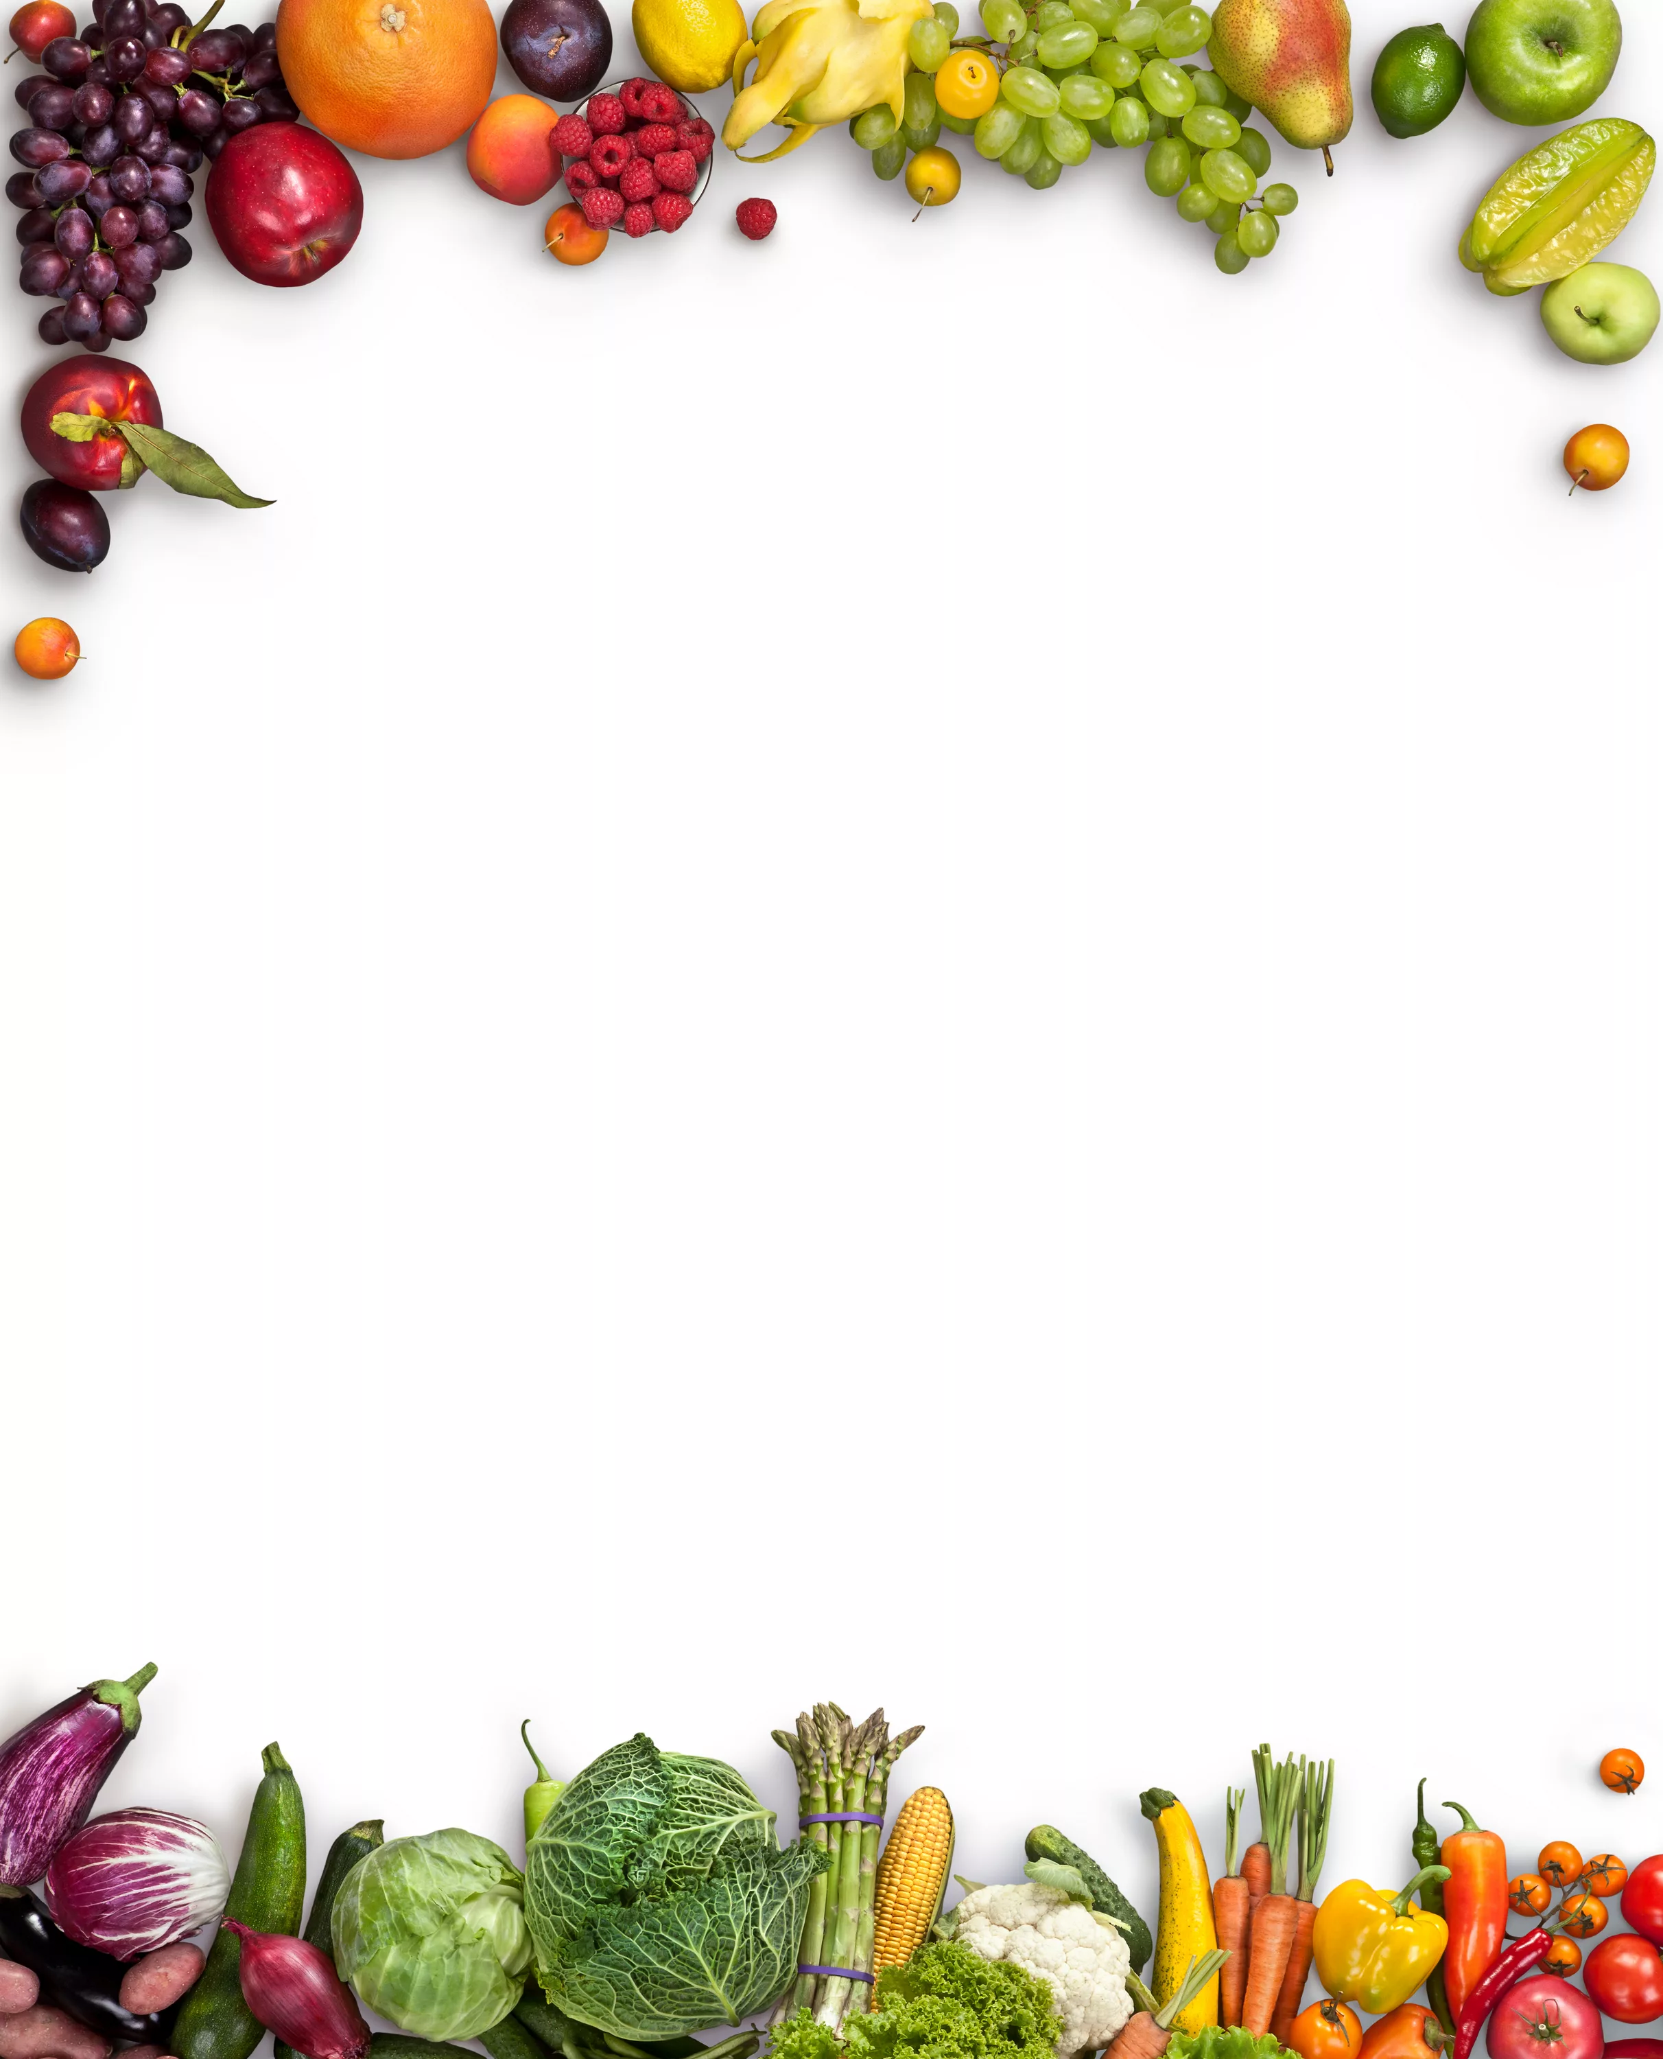
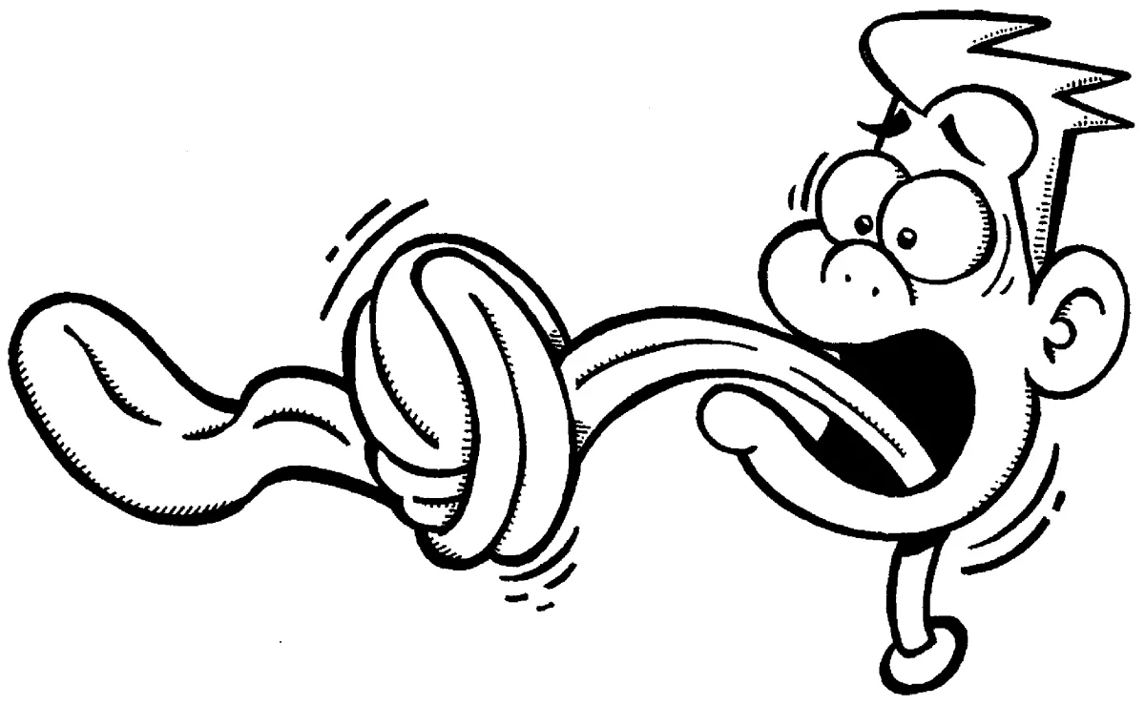
Correct English pronunciation!

Slide 3
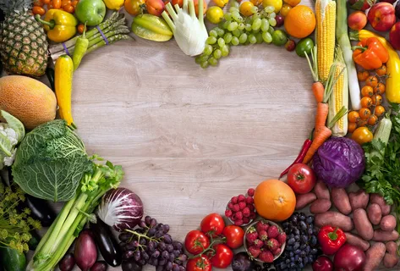
Traditional British cuisine

Slide 4
What do you have for breakfast/lunch/dinner?

Slide 5
Traditional british dishes
Each of the four countries, England, Ireland, Scotland, and Wales have many specific dishes . These dishes are so familiar, so they are eaten in many countries to some lesser or greater degree.
There is much dispute about which is truly the English national dish, because we can observe quite a lot of similar dishes. Number one on the list for many years has been roast beef and Yorkshire puddings, followed closely by fish and chips.
Irish Stew is a thick hearty dish of mutton, potatoes, and onions and undisputedly the national dish of Ireland. Within the dish there are, which are synonymous with the island, potatoes being one of many ingredientsthe most recognized.
Haggis is regarded as the Scottish national dish. It is a sheep's stomach stuffed with offal, suet, onions, and oatmeal. The result is an exotic type of sausage.
Cawl is the national dish of Wales. It is also a stew and made from bacon, Welsh lamb or beef, cabbage, and leeks.
Despite the fact that there are different dishes in these four contries, the most famous tradition in the UK is the so-called “Fife O’clock” ,a tea break at 5:00 pm.As it is a break, little time is devoted to this case, but there are few people who will miss it. Actually, British people drink much tea every day. They don`t have much food at this time. They mostly give their preferences to a few sandwiches. Tea with a little amount of milk is also possible.

Slide 6
This text is about…
This text describes…

Slide 7
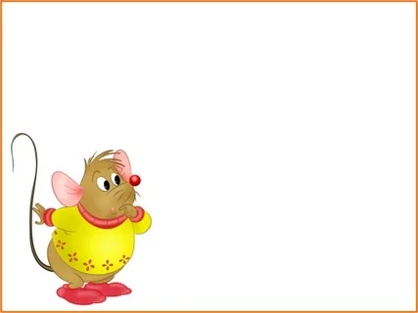

Slide 8
Many (много) a few (немного) few(мало) much(много) a little (немного) little(мало)
Countable Uncountable
A lot of(много)

Slide 9
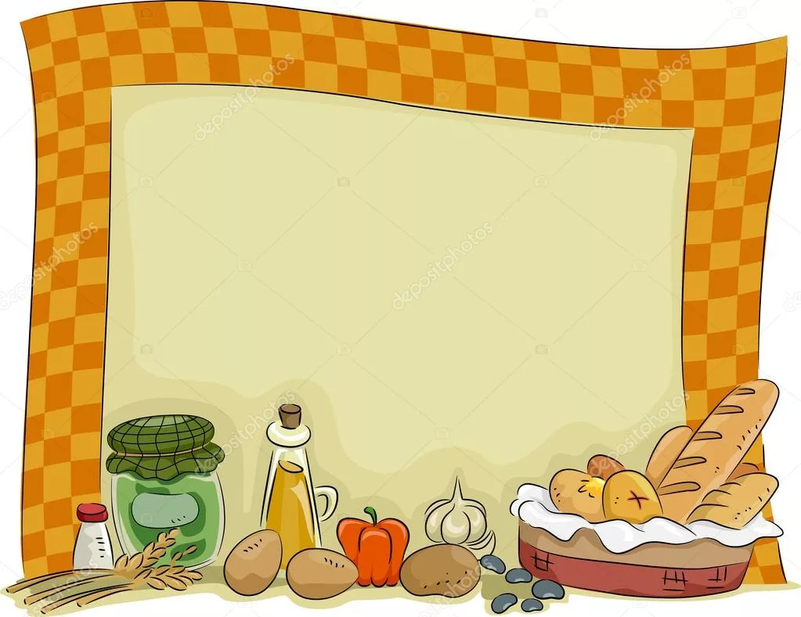
1.What ingredients does Irish Stew have?Enumerate them! 2.What do British do at 5 pm?What do they prefer eating during this break? 3.What is «Cawl»?

Slide 10
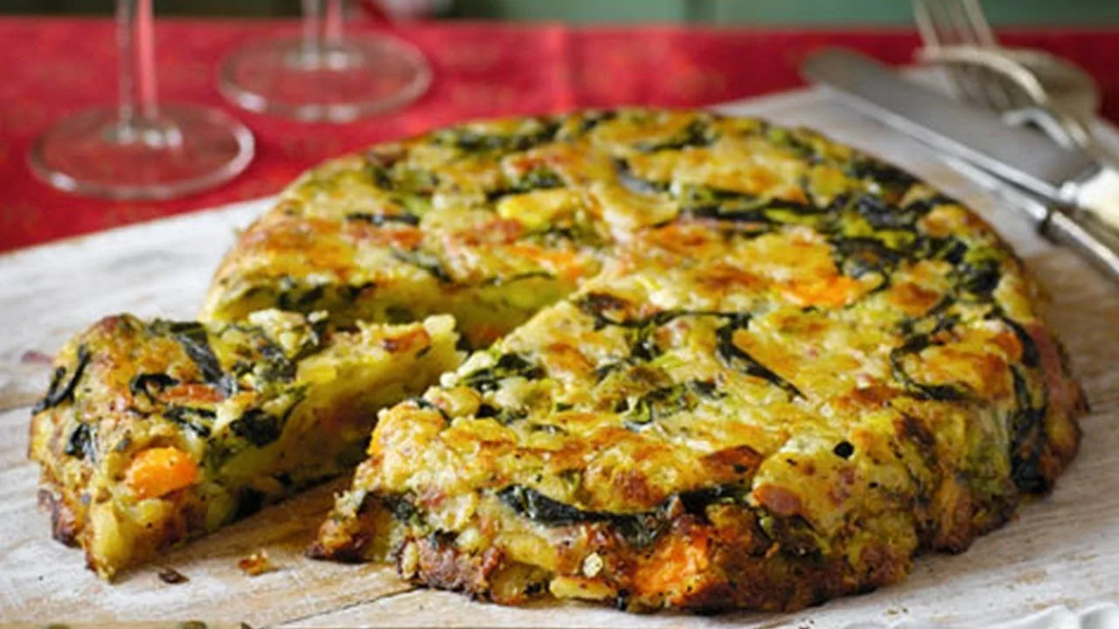
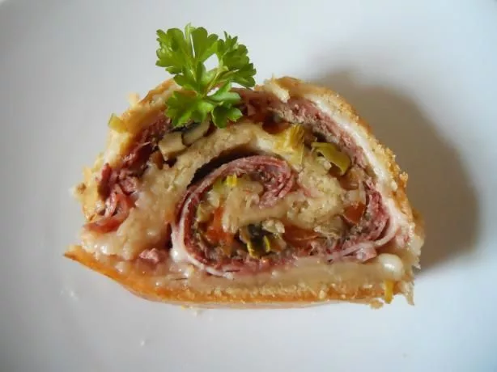

Slide 11
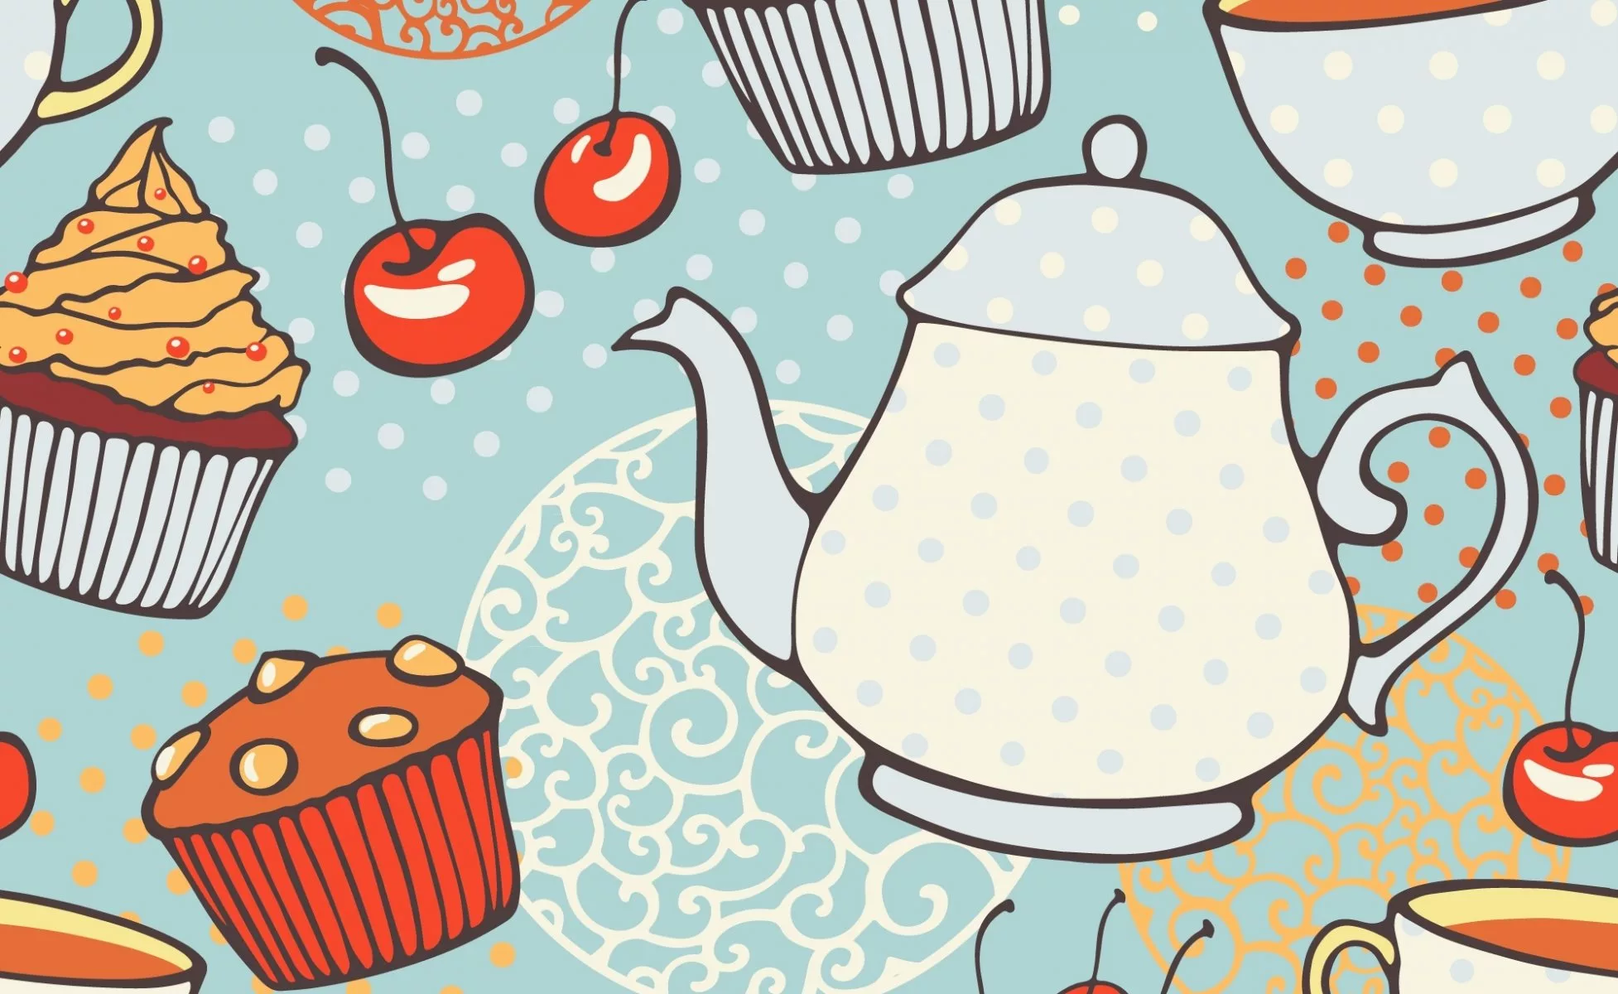
Hometask: to make up a composition about your favourite dish and to make up a list of products which are necessary for it!

