Slide 1
Let’s watch the video about Saint Valentine ‘s Day and underline the words related to this holiday
Love chocolate tea family cards tree date match
February competition 14 January party butterfly gifts
Boxes letters couple songs literature flowers 13

Slide 2
Let’s talk about St.Valentine making
sentences in the Past Simple:
1.Valentine (to live) in Rome.
2.Valentine (not to like) the Emperor.
3.His favourite activity (to be) to marry couples.
4.Valentine (to keep) on performing marriage
ceremonies.
5.The men of the Emperor (to catch) Valentine.
6.People (to support) Valentine near the jail.
7.They (to throw) flowers and notes.
8.Valentine (to leave) a special note to his friend, Augustine.

Slide 3
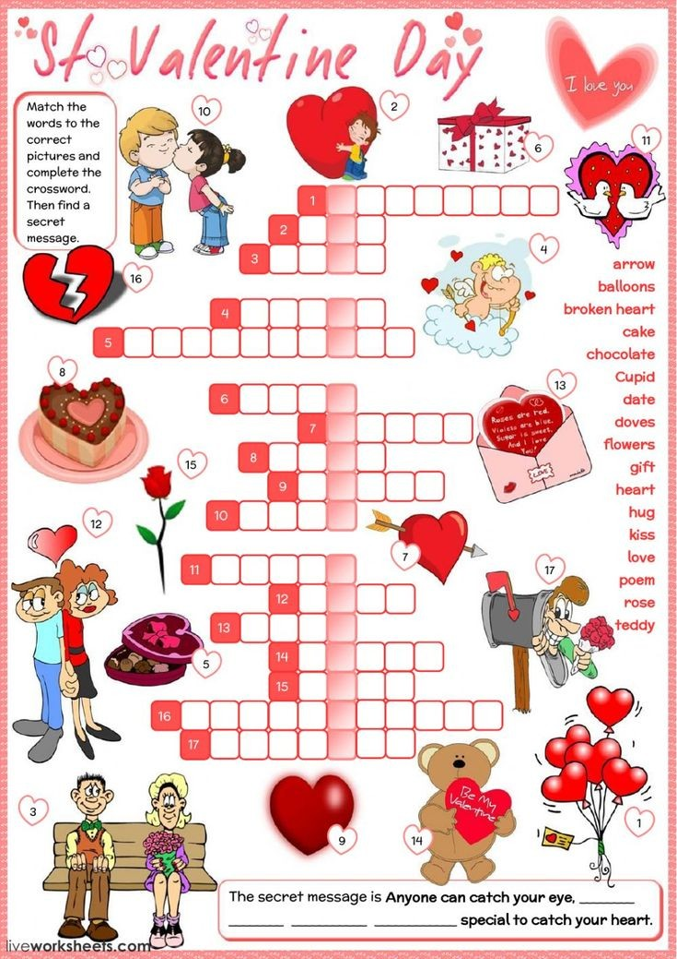

Slide 5
MUSIC:
listen to the piece of the song and try to put the words into the right order
Translate the song but try to make the translation as beautiful as you can (try to be romantic and poetic)
There’s something in your eyes that is saying tonight
I’m not a child anymore, life has opened the door
To a new exciting life
I lose control when I’m close to you babe
I lose control don’t look at me like this
There’s something in your eyes, is this love at first sight
Like a flower that grows, life just wants you to know
All the secretes of life
I lose control because of you babe
I lose control when you look at me like this
It’s all written down in your lifelines
It’s written down inside your heart
You and I were just made
To love each other now
Forever and a day
You and I just have a dream
To find our love a place
Where we can hide away

Slide 6
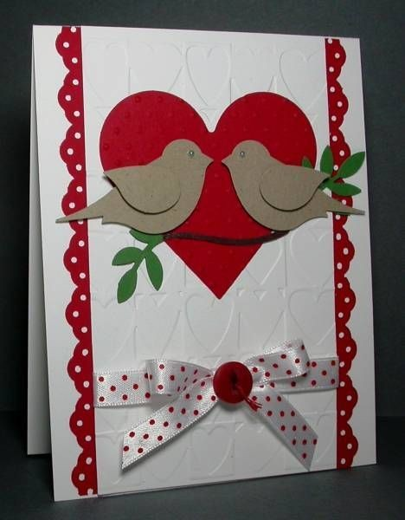

Slide 7
*Create your valentine card and then you are to describe it.
Begin your descriptions with the following words:
-There is…….
-There are…..
-It has….
-You can see……
On the valentine card

