Slide 1
Do you know English well?

Slide 2
The 1st contest of the game is called «A magic 5».
Name 5 colours.

Slide 3
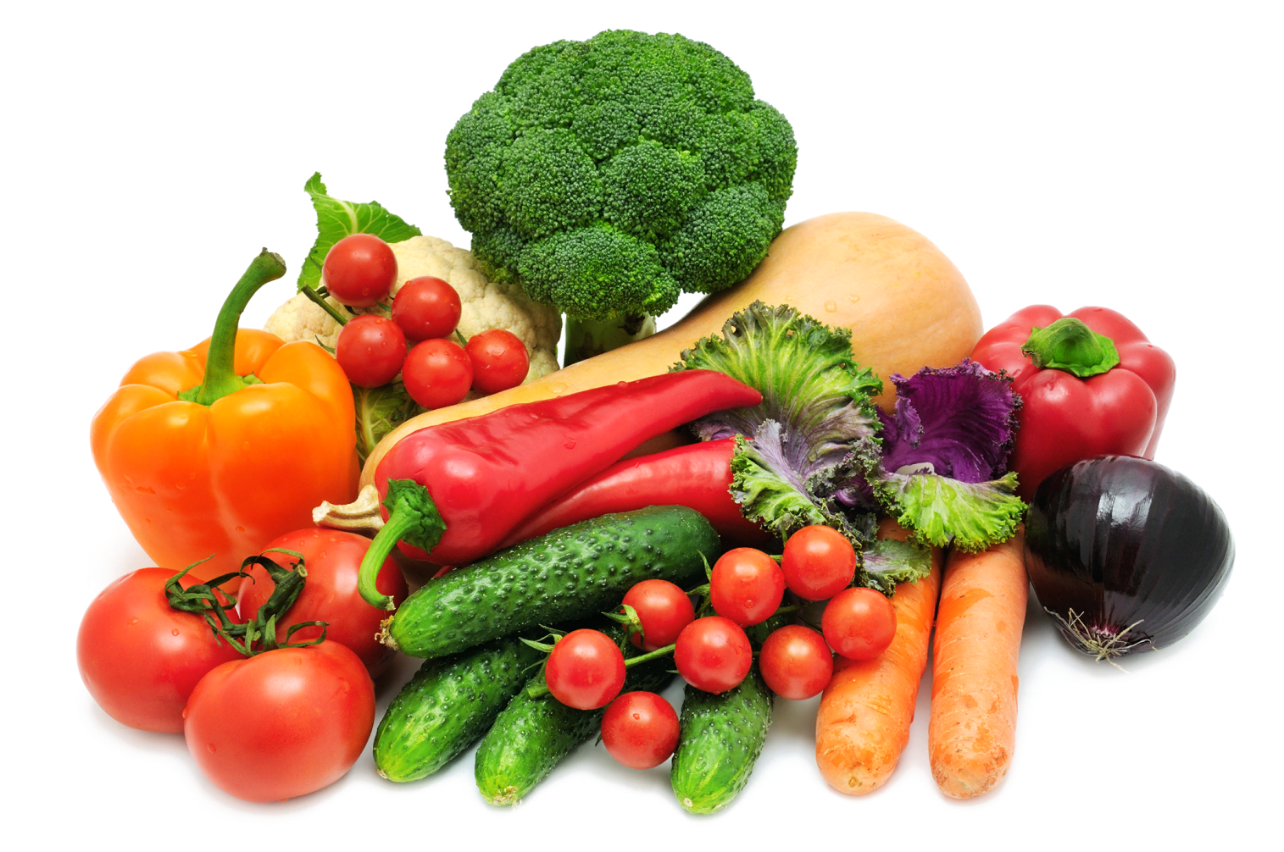
Name 5 sorts of vegetables.

Slide 4
Name 5 school subjects.

Slide 5
Name 5 sorts of fruit.

Slide 6
Name 5 summer sports.

Slide 7
Name 5 winter sports.

Slide 8
Name 5 professions.

Slide 9
Name 5 wild animals.

Slide 10
The 2nd contest of the game is called ”Lazy Sentences”
Make up the sentences from these words.
Cooking, is, she, now

Slide 11
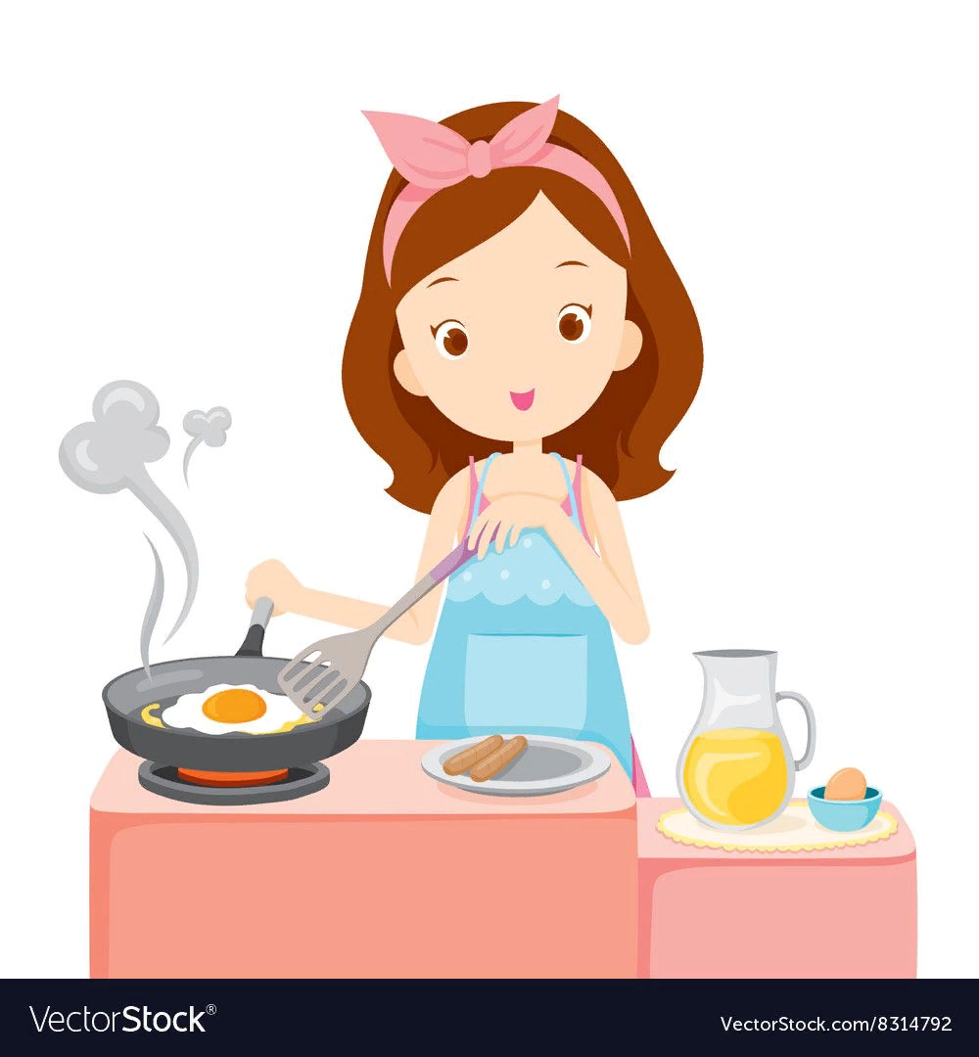
She is cooking now.

Slide 12
My, is, mother, TV, watching

Slide 13
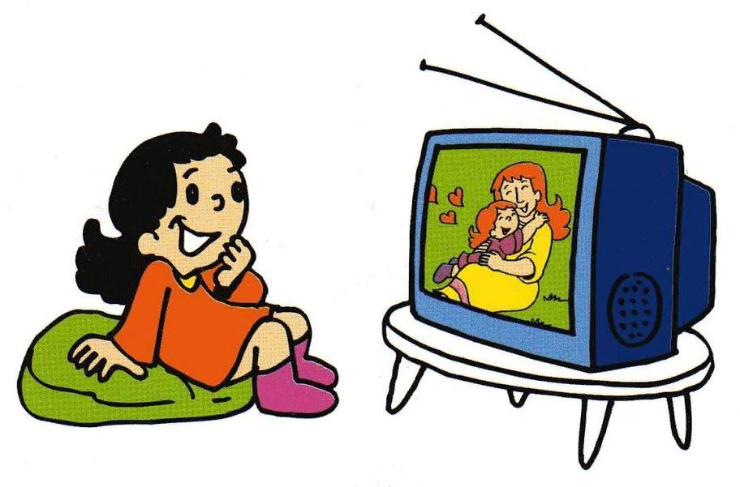
My mother is watching TV.

Slide 14
Alice, homework, doing, is, her

Slide 15
Alice is doing her homework.

Slide 16
Football, Peter, is, at the moment, playing.

Slide 17
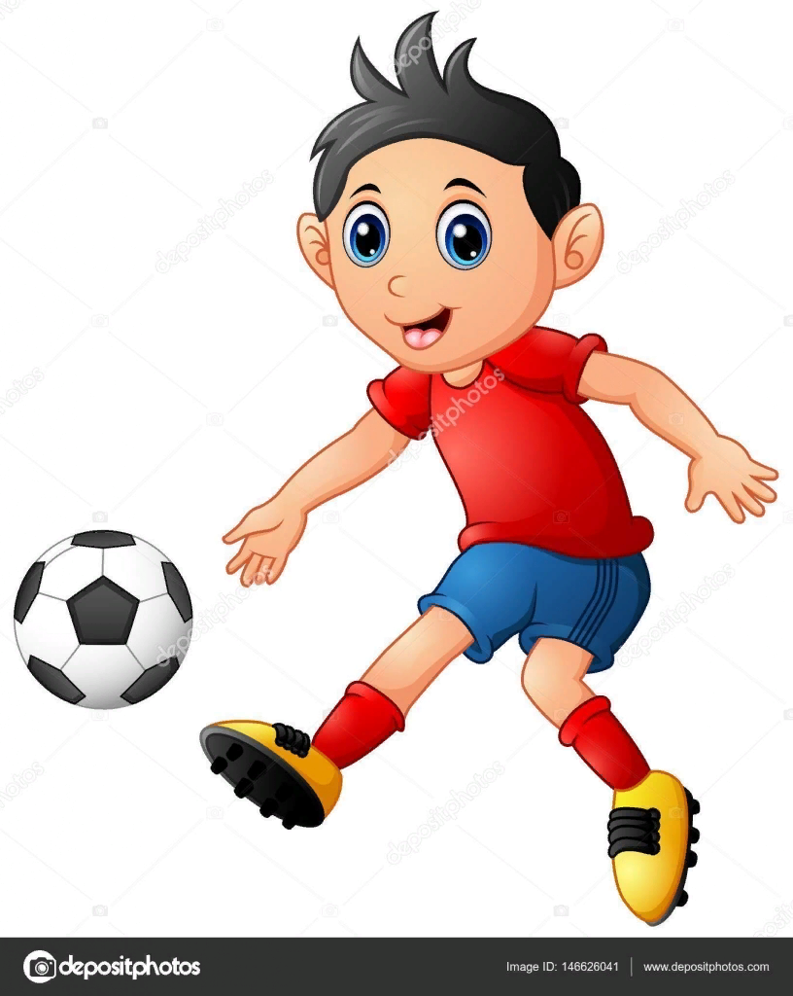
Peter is playing football at the moment.

Slide 18
The 3rd contest of the game is called “Complete the sentences.”
1. The first day of the week is …
2. The colour of the sun is …
3. You drink this when you are thirsty.
4.The month that follows October is …

Slide 19
Complete the sentences.
6. A domestic animal is …
7. You grow flowers in a…
8. Eight plus one is…
9. A very big animal is …
10. Boys and girls at school are…

Slide 20
The 4th contest of the game is called “Correct the mistakes”.
My brother like fruit pie.
My brother likes fruit pie.

Slide 21
Does you eat a lot of bread?
Do you eat a lot of bread?

Slide 22
Does you like chocolate? – Yes, I like.
Do you like chocolate?-Yes, I do.

Slide 23
Does your mother reads books?
Does your mother read books?

Slide 24
The 5th contest of the game is called "Solve the riddles”.
Not a bird, not a butterfly, I can fly high in the sky.

Slide 25
a plane

Slide 26
I’m tall and green,
I’m in the garden.

Slide 27
a tree

Slide 28
It’s not a man,
it’s not a woman,
but it teaches us.

Slide 29
a book

Slide 30
The End

