Slide 1
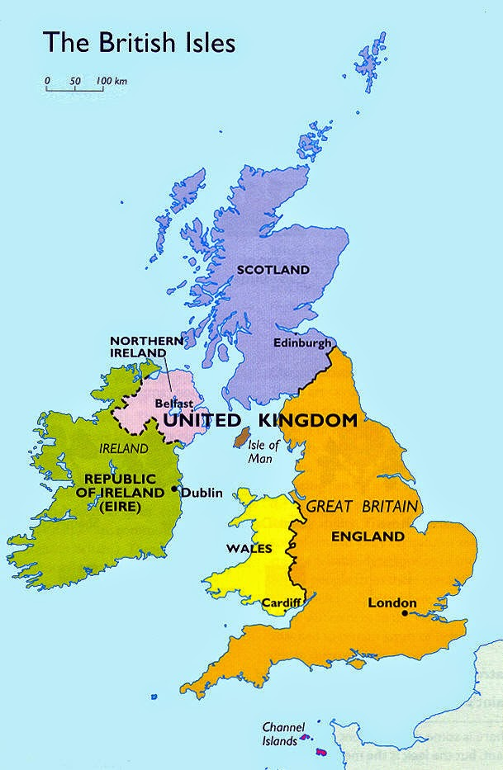
«Five o’clock Tea»

Slide 2
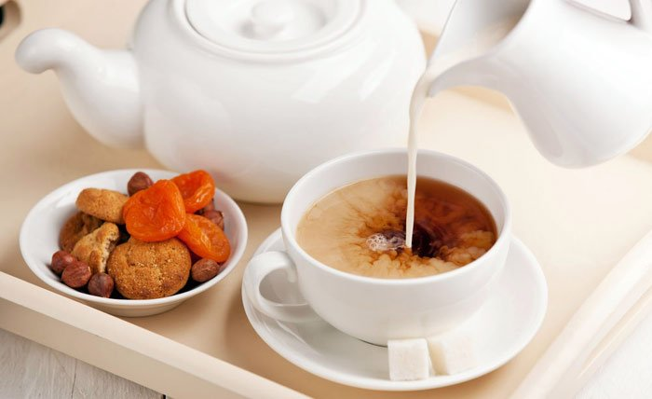
«Five o’clock Tea»
Цель исследовательской работы:
Анализ британской традиции пятичасового чаепития.
Задачи:
Изучить историю появления данной традиции;
Рассмотреть современный вариант британского чаепития;
Изучить правила сервировки стола;
Определить особенности британского чаепития.

Slide 3
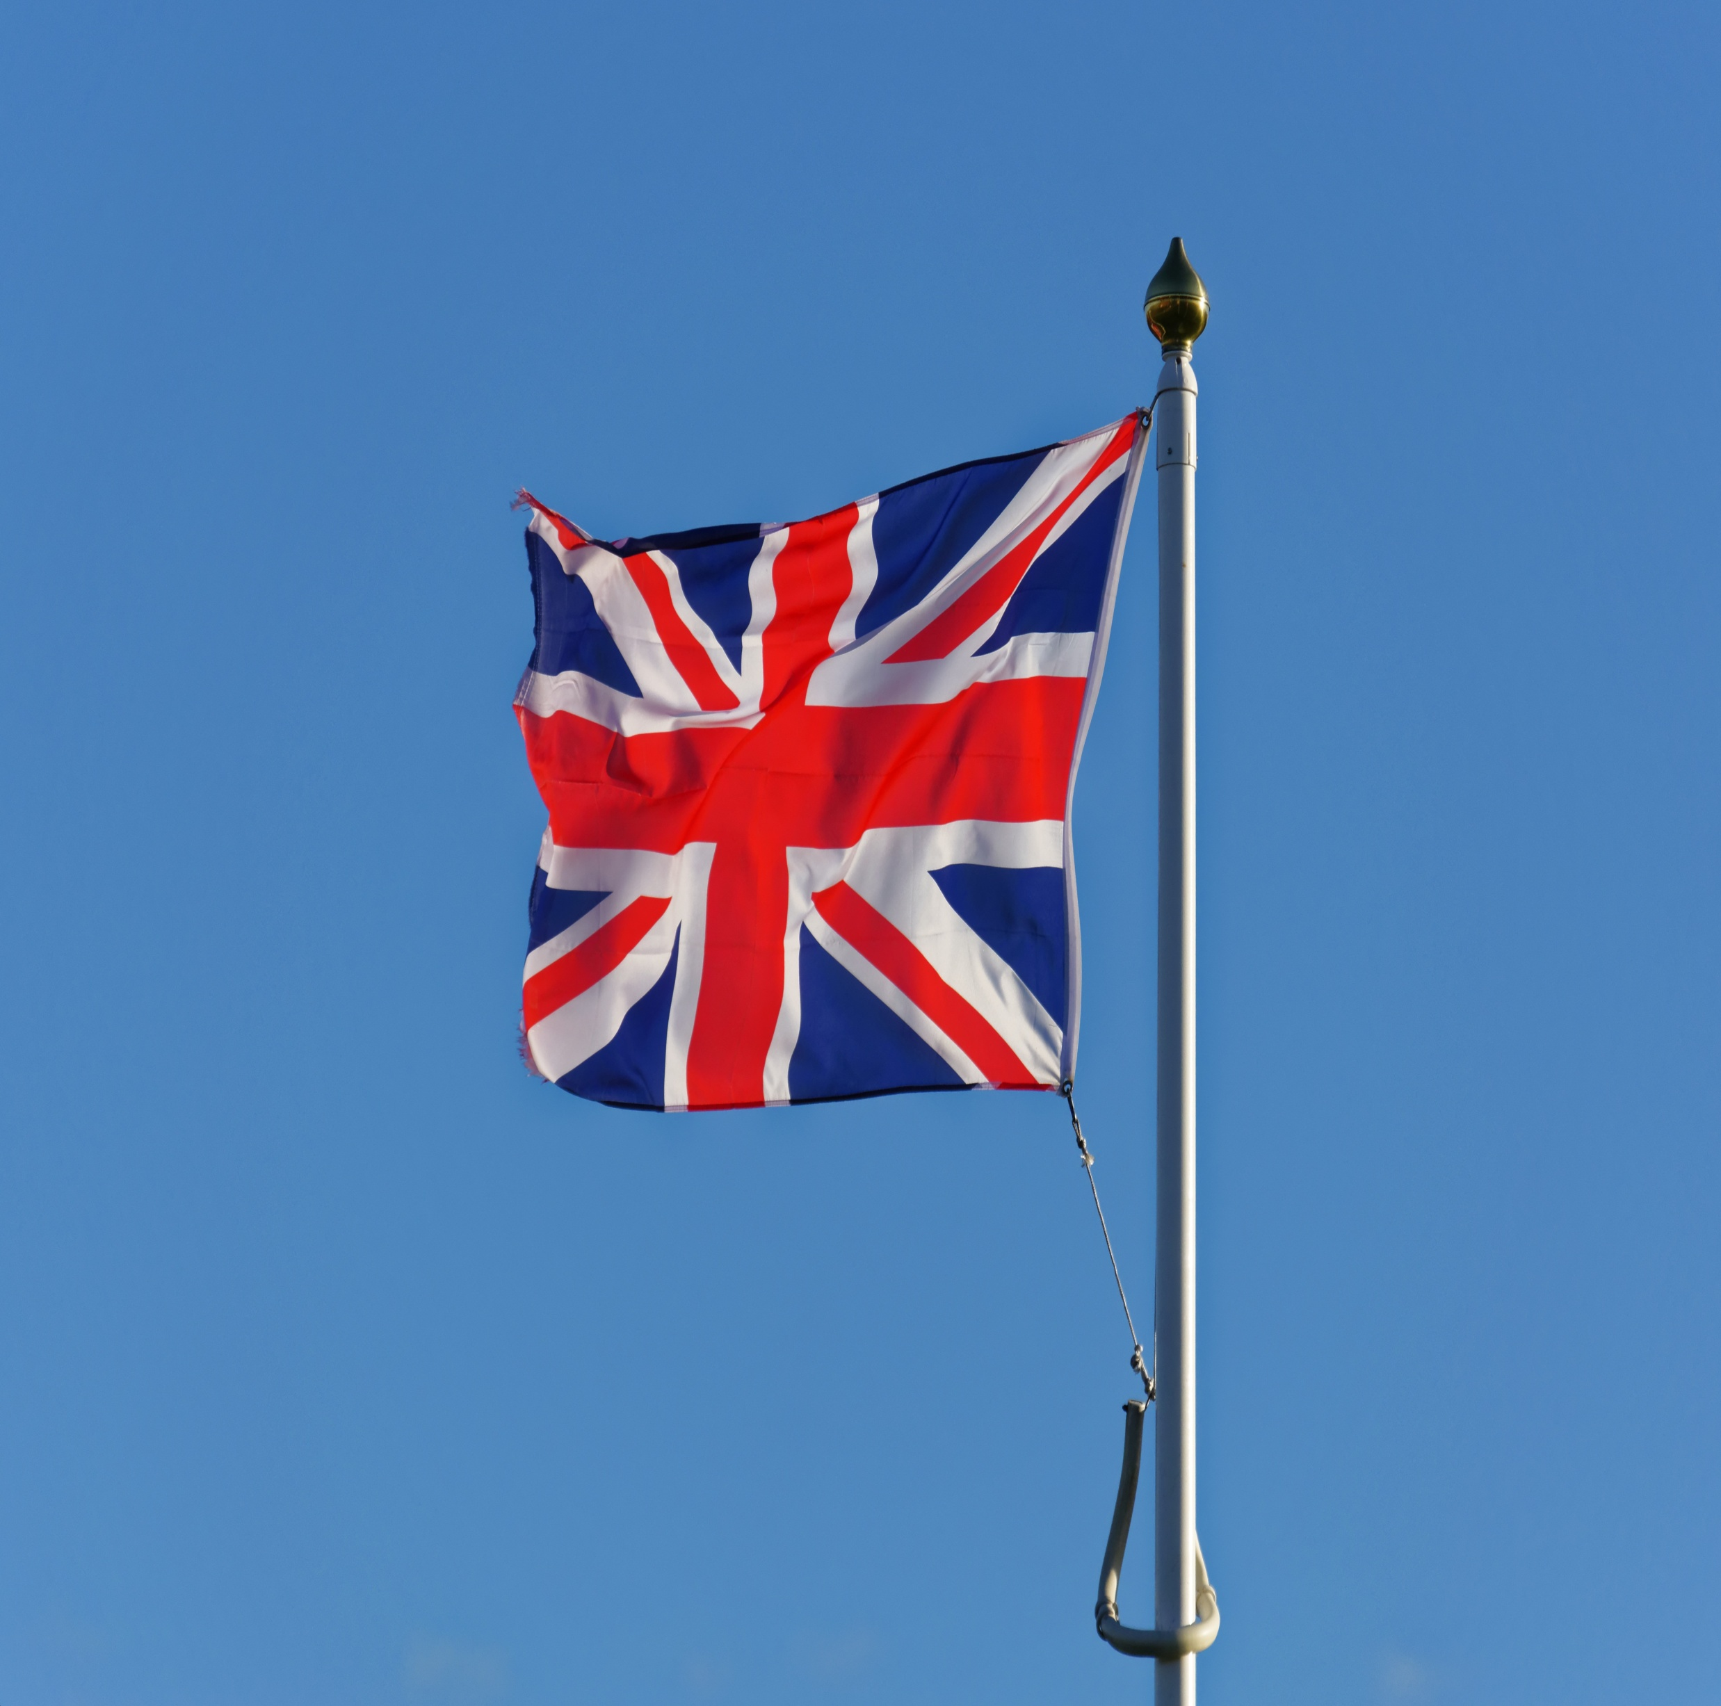
Tea – is the national drink of the British. Britain imports about 20% of all the world’s tea.

Slide 4
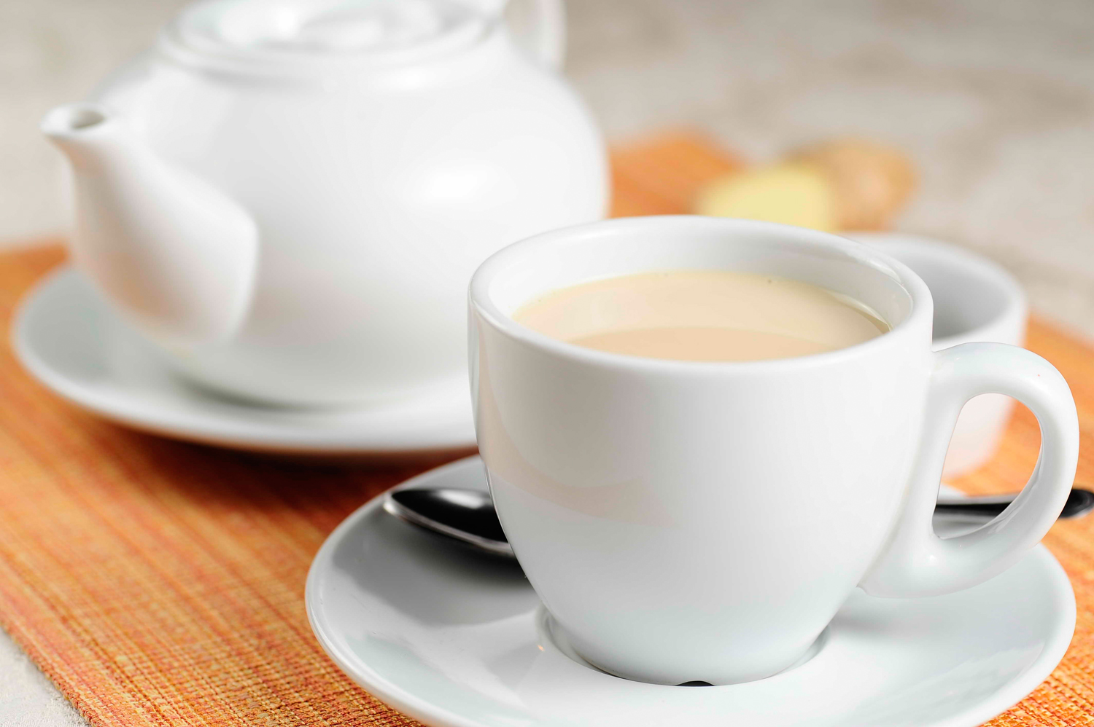
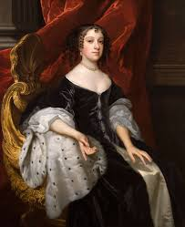
It was introduced in Britain in 1657 by Catharine King Charles’s wife.

Slide 5
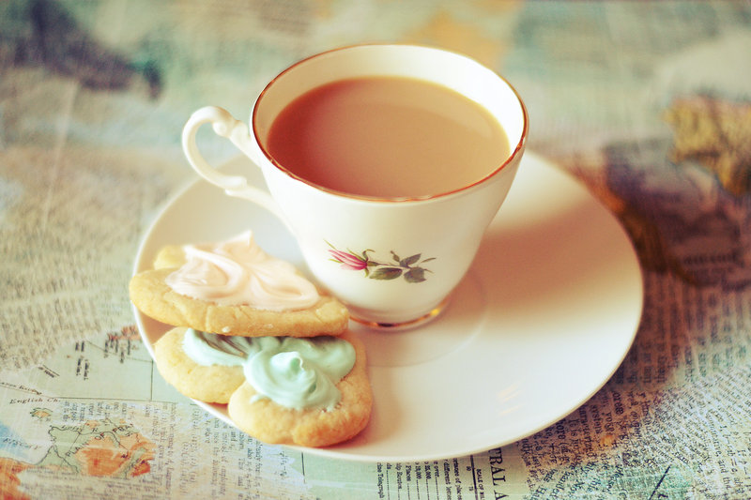
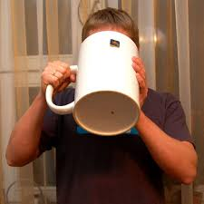
The British drink more than any other nation – about 4 kilos a head or 1650 cups of tea a year.

Slide 6
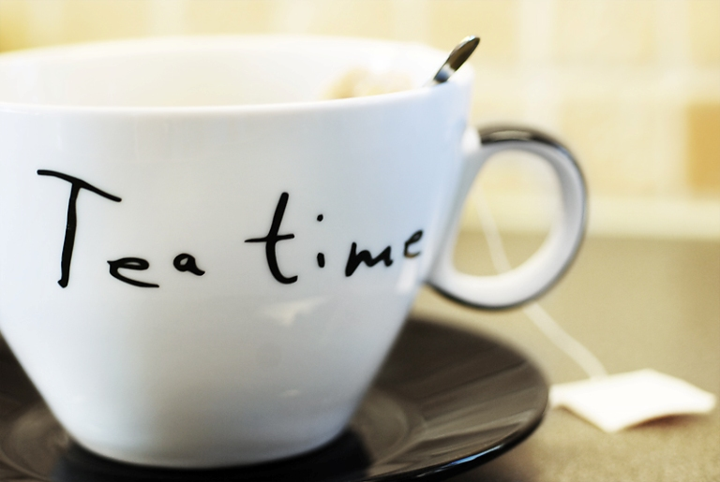
Tea is the third meal of the day. In 5 o’clock all the British take a break and go to drink tea.

Slide 7
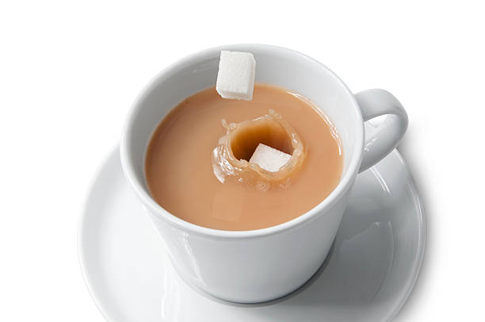
Most people in Britain prefer a rich, strong cup of tea with milk, and sugar is sometimes added to taste.

Slide 8
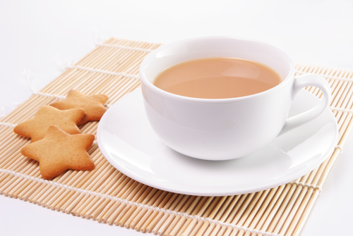
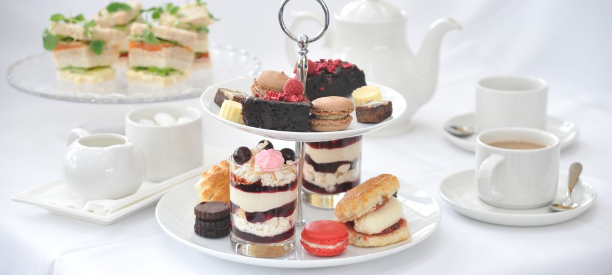
It between 4 or 5 o’clock. On the table there is tea, milk or cream, sugar, bread, cakes and jam.

Slide 9
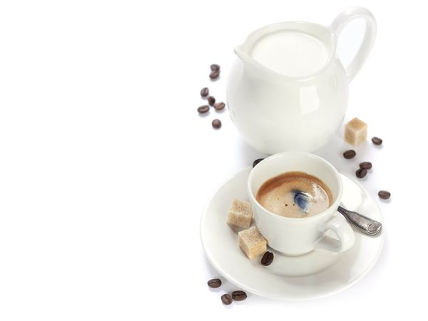
It’s even more popular than coffee, which is favoured throughout Europe and America.

