Slide 1
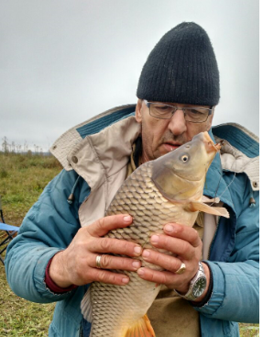
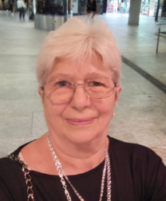
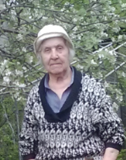
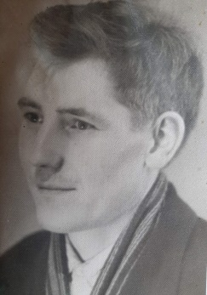
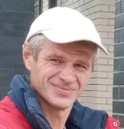
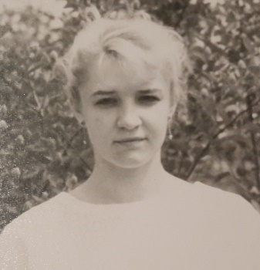
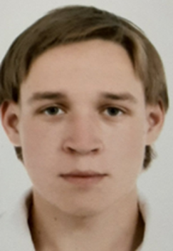
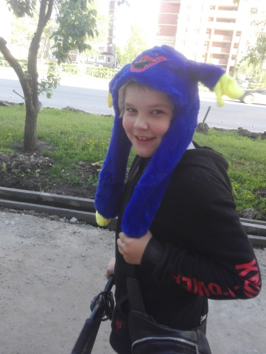
My family tree

Slide 2
This is my family.
My family is not very big.
I have two older brothers,
two grandmothers,
two grandfathers and parents

Slide 3
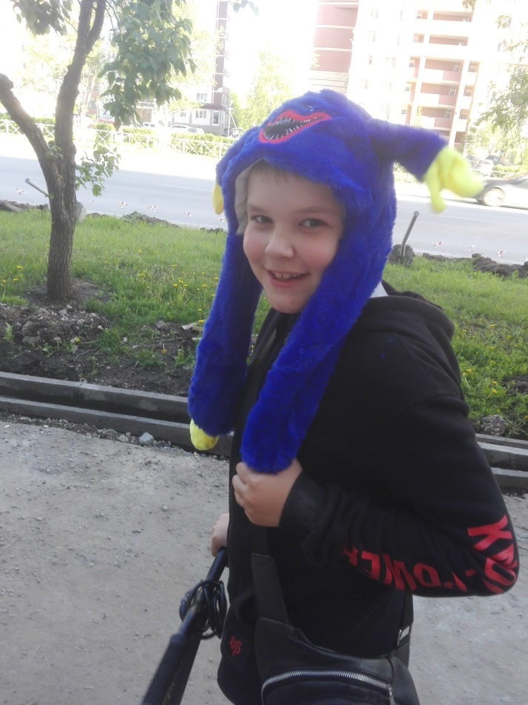
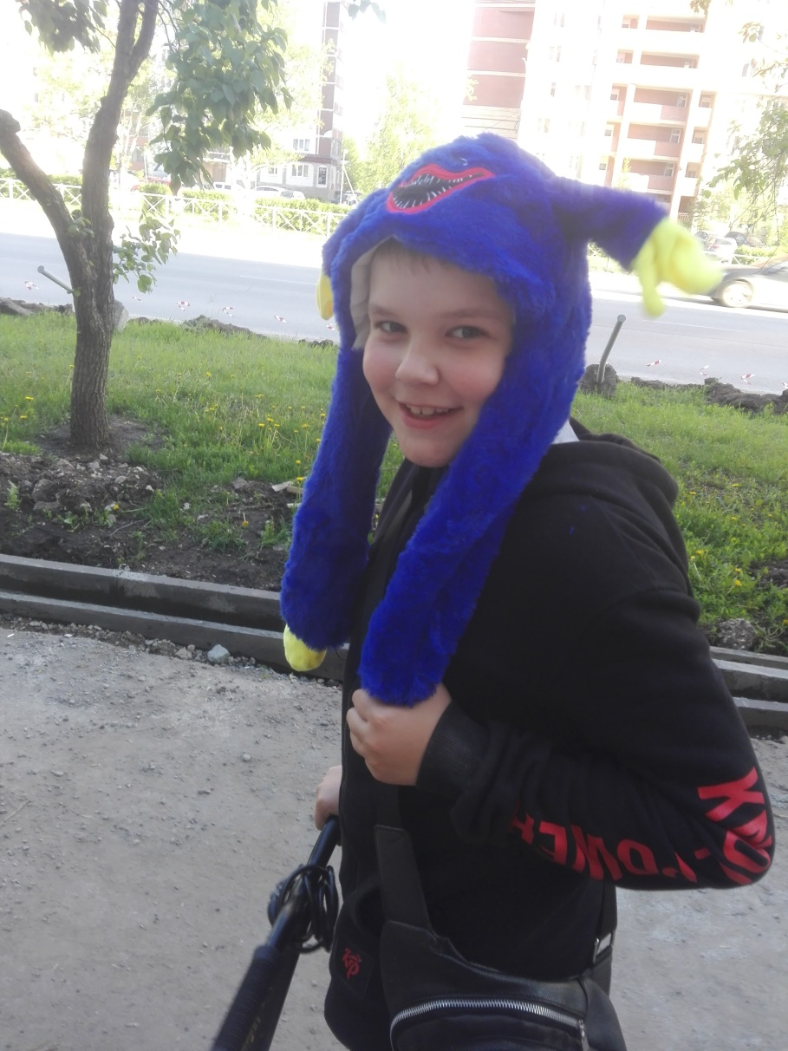
This is me.
My name is Slava.
I am in fifth grade at school.
I love listening to music,
sing and play computer games.

Slide 4
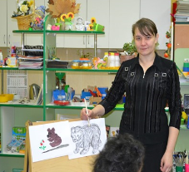
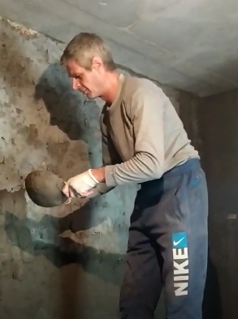
These ary my parents.
My mothe”s name is Lyudmila.
She works in a kindergarten.
My dad”s name is Zhelko.
He works as a builder.

Slide 5
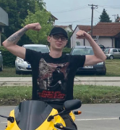
These are my brothers.
Their names are Sacha and Dejan.
Sacha study at the university.
He will a programmer.
Dejan works as a
postal courier in Serbia.

Slide 6
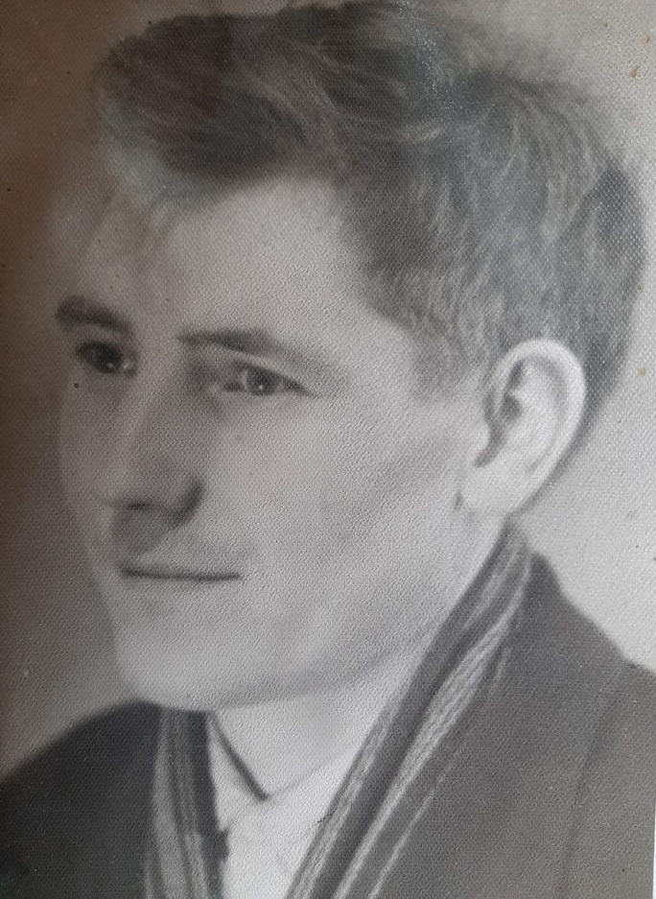
These are my grandfathers.
Grandfathers are clead a long time ago.

Slide 7
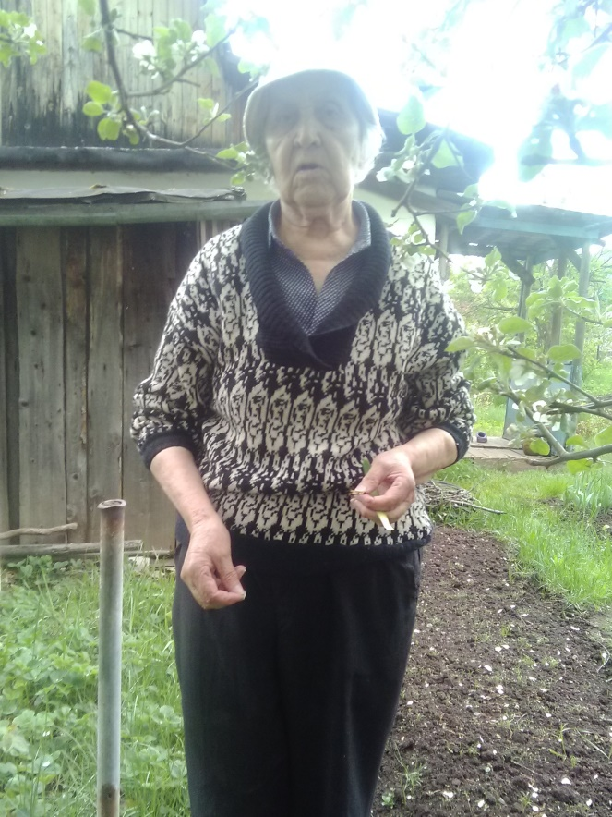
These are my grandmothers.
Grandmother Slavica
livers in Serbia.
She has her own house
with garden.
Grandmother Rufa has
own cottage with garden.

